Slide 1
Software QA and Testing with Automation using Selenium WebDriver Course 1, Class 5 Deck 3 Selenium WebDriver
Instructor
David F Wagoner
PMP, CSQE, CMQ/OE
Copyright 2015 Montgomery College, David F Wagoner

Slide 2
Classes
The TestCase class contains the unittest framework of three sections:
Arrange
Preconditions for testing – Test Fixture
Act
Exercise the functionality
Assert
Verify outcome matches expected results

Slide 3
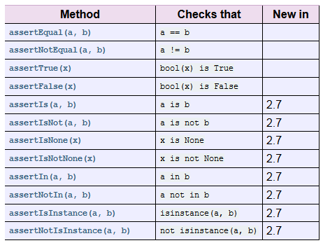
unittest assert Methods
Method(a,b, msg)
None is to check whether empty, null or nil
Courtesy python.org
https://docs.python.org/2/library/unittest.html

Slide 4
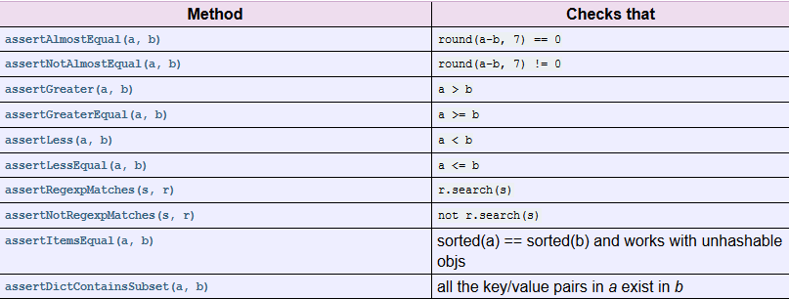
More assert Methods
See the Python wiki for more tool taxonomy for Testing
https://wiki.python.org/moin/PythonTestingToolsTaxonomy

Slide 5
Structuring Test Cases
Proper structure supports the construction of scripts into a test suite
A Class is declared based on the TestCase class and unittest framework
The structure is:
Before the Class, invoke needed libraries
Declare the Class
A setup section called before each method (test)
One or more methods that exercise a part or all of a test
A cleanup section to release resources used in the test

Slide 6
Class Methods
Methods are defined using the ‘def’ keyword
For automated WebDriver tests, methods aside from setup and teardown must begin with ‘test’
def setup() – takes no arguments
create drivers and open windows, navigate to base url
def test_lookup-by-category(self)
steps to find search box, look something up and do a test
def teardown() – takes no arguments
release resources used in test

Slide 7
Lab 1 – Create unittest Case
Use your previous script and save it to a new name
Change the invoke section (first lines)
import unittest
from selenium import webdriver
Notes:
searchproductsinglemethod

Slide 8
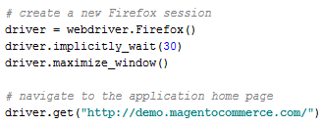
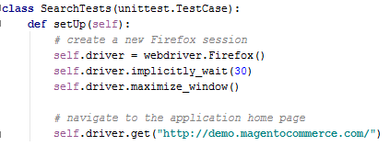
Restructure Code
Change this to that
Notes:
searchproductsinglemethod

Slide 9
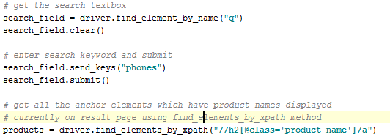
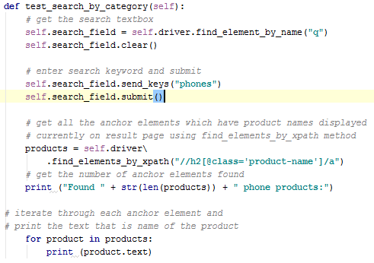
Restructure Code
Change this to that
Indent the method one tab or 5 spaces under the Class
Notes:
searchproductsinglemethod

Slide 10

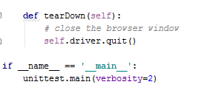
Restructure Code
Change this to that
Notes:
searchproductsinglemethod

Slide 11
Add a Method
Now we’ll add a method to the SearchTests class
Again, save your file to a new name
Were inserting a class named
test_search_by_name

Slide 12
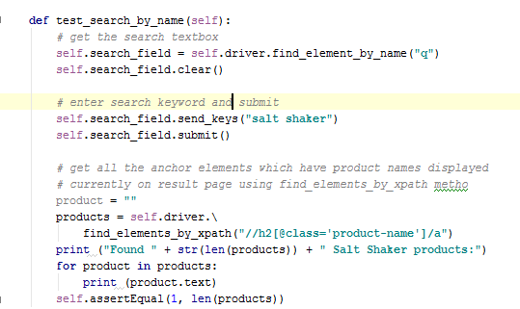
Lab 2.2 Add a Method
Insert the following below the existing class and above the tearDown() method

Slide 13
Lab 2.3 Using assert
Add an assert command to test_search_by_category immediately after the x-path query and before the print commands
self.assertEqual(3, len(products))
This should run w/o failing
Now change the count (3) to a 2 and run it again to observe the differences
Add similar code to test_search_by_name and change the count to something > 1

Slide 14
Class Level Methods
In the current lab example, Firefox is initiated and shut down twice, each time a method is invoked
Using a class level method performs that only once, reducing redundant open and close commands
Above the setUp() and tearDown() methods, add ‘@classmethod to the line above each method
Rework the code inside each driver to use the ‘cls’ prefix instead of ‘self’
Debug and run the code

Slide 15
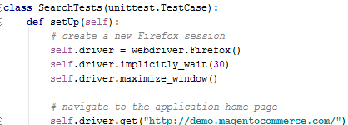
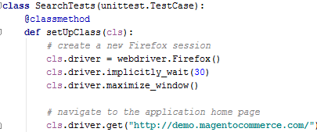
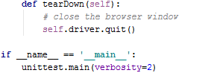
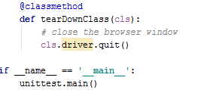
Lab 2.5 Class Methods
Change this to that
Change this to that

